Slide 1
Introduction to Bootstrap and Monte Carlo Simulation Yuchen Xiao Graduate Research Assistant Prof. Michael J. Pyrcz, Ph.D., P.Eng. Associate Professor Hildebrand Department of Petroleum & Geosystems Engineering University of Texas at Austin Texas Center for Geostatistics University of Texas at Austin Bureau of Economic Geology, Jackson School of Geosciences University of Texas at Austin Date: August 29th , 2019

Slide 2
Objective
Motivation:
Subsurface modeling deals with huge uncertainty! We do great work, pat on the back!
How can we quantify and reduce the uncertainty is key!
We can use uncertainty to better our estimation and prediction!
Plans:
Understand what is uncertainty and different approaches to resolve it
Comparison between traditional statistics methods and machine learning
Introduce powerful bootstrap, a resampling method, that allows estimation of the sampling distribution of almost any statistic
Introduce Monte Carlo Simulation, a computational algorithms, that rely on related random sampling to obtain numerical results. Popular in modeling phenomena with significant uncertainty in inputs
How they tied to each other from examples
Scientific Question:
How confident are we in our geological inputs?
How can we improve our estimation and prediction?

Slide 3
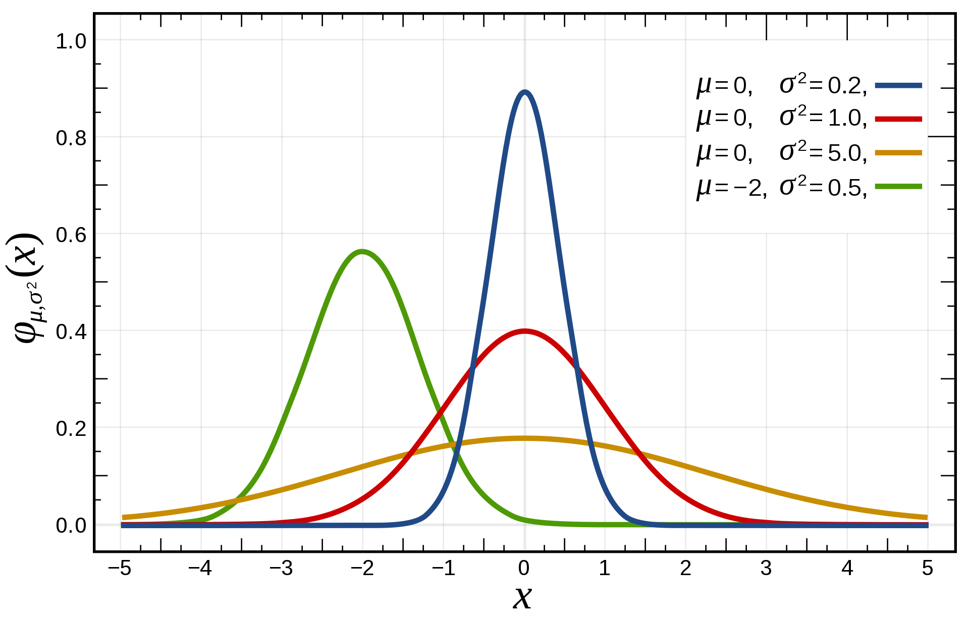


Parametric Distribution
Normal Distribution
Predictive model!
Short-hand notation
Probability density function (PDF)
https://en.wikipedia.org/wiki/Normal_distribution
Notes:
Give background information on parametric distribution, PDF function and short-hand notation

Slide 4
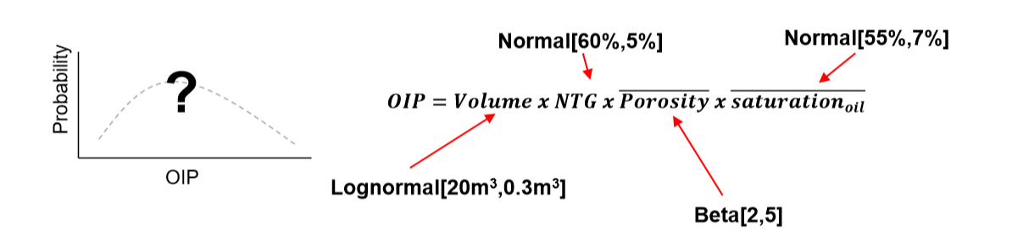

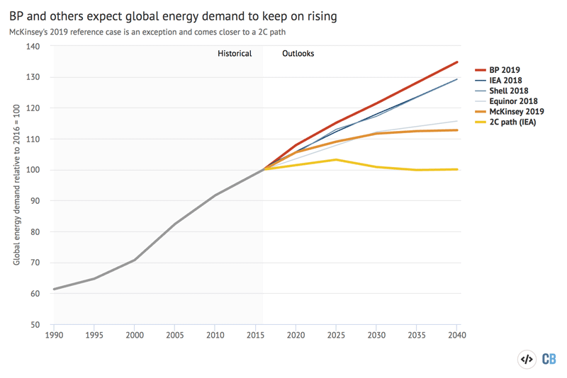

Uncertainty in Estimation and Prediction
From Pyrcz Intro to Geostat slides
https://www.nairaland.com/4023637/mothers-daughters-look-same-age
Parametric vs. Nonparametric Prediction
https://www.carbonbrief.org/analysis-bps-outlook-for-fossil-fuels-could-be-undermined-by-slowing-energy-demand/global-primary-energy-demand-growth-in-the-bp-energy-outlook-2019
Notes:
Two things I am trying to convey:
1, On the left, I want to emphasis the uncertainty in the estimate; a)the input for the equation is not just a number, but a random variable; b), different estimate comes from different metric and with different weights assigned to them
2, On the right, I want to ask them two question, a) can you discern who is older vs younger, and b) how much older do you think?
o. My dad is bald, he is chubbier, and I have designer glasses → I am younger → Bayesian thinking
o. we are finding patterns and features → parametric vs nonparametric → traditional statistical methods vs machine learning

Slide 5
Traditional Statistical Methods and Machine Learning
Traditional Statistical Methods:
Developed and practiced when there were not an abundance of data
Heavy assumptions on data, e.g. iid (independent and identically distributed) and distribution, e.g. Gaussian distribution
Still work with relatively fewer data
Use statistical inference as a way to explain the relationship between independent variables and dependent variables; prefer with fewer independent variables, i.e. curse of dimensionality
Mainly parametric methods, i.e. assumption on model
Use repeated sampling technique to explore pre-defined uncertainty space, e.g. pre-assumption of a Gaussian distribution
Machine Learning:
Developed several decades ago, previously handicap by the insufficient amount of data and limited computational power
Less assumptions on data and offers outstanding prediction accuracy
e.g. image recognition, Alpha go
Lack the ability for inference and the results can be spurious
i.e. can not explain the path to reach the conclusion
Many advanced methods are nonparametric methods, i.e. random forest, neural networks
Able to handle a huge amount of independent variables, AKA: features
It is just an optimization problem!
However, they have more common areas !!!

Slide 6
Bootstrap
Bootstrap
Method to assess the uncertainty in a sample statistic by repeated random sampling with replacement
Assumption
Sufficient, representative sampling
Limitations
Assumes the samples are representatives
Assumes stationarity
Does not account for area of interest
Assumes independent sampling
Only accounts for uncertainty due too few samples, e.g. no uncertainty due to changes away from data (spatial correlation)
From Pyrcz’s slides in Intro to Geostatistics

Slide 7
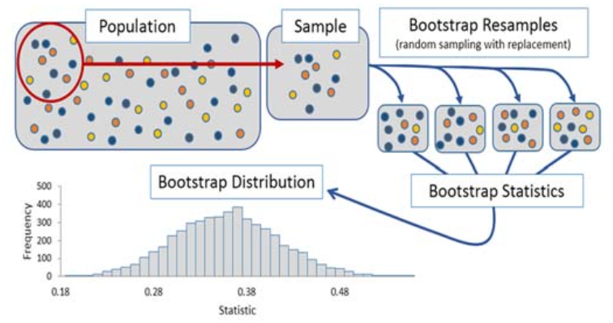
Bootstrap
Estimate the pore pressure in this grid for simulation
Data Source: wellhead pressure etc.
Population: the entire grid space
Sample: wellhead pressure at some locations
1
1
2
How to offset the effect of Outlier ?
215 psi
3
294 psi
4
237 psi
5
210 psi
50,000 ft
228 psi
6
224 psi
7
243 psi
Banjanovic, Erin S., and Osborne, Jason W. (2016). Confidence Intervals for Effect Sizes: Applying Bootstrap Resampling. Practical Assessment, Research & Evaluation, 21(5).
50,000 ft
Notes:
o. When there are outlier, the average value is not a good estimate to use for the grid pore pressure → we use bootstrap to get a better estimate!

Slide 8




Bootstrap
Mean pore pressure
(215 + 237 + 294 + 228 + 210 + 224 + 243) / 7 = 235.86 psi
Bootstrap samples:
First sample: 1,3,6,4,4,7,3
Second sample: 3,6,4,2,5,3,5
Third sample: 6,3,6,3,1,3,7
Forth sample: 7,3,5,3,6,4,2
etc.…
Mean {$ℓ$=1}
Mean {$ℓ$=2}
Mean {$ℓ$=3}
Freq
Freq
Freq
1 2 3 4 5 6 7
1 2 3 4 5 6 7
1 2 3 4 5 6 7
Sample Number
Sample Number
Sample Number
Find sample mean for each bootstrap sample and shown as a PDF
AKA. Central Limit Theorem
95 % confidence interval
Prob
210 psi
294 psi
Minimum
Maximum
Sample Mean,
$ℓ$ = 1,…, L
Notes:
o. A confidence interval is much better than a uniform density bound by the max and min values of the data
o. A confidence interval give much information as you have explore, to some extent, the uncertainty space

Slide 9
Monte Carlo Simulation
Monte Carlo Simulation
Broad class of computational algorithms that rely on repeated random sampling to obtain numerical results
Assumption
Sufficient, representative sampling
Limitations
Assumes the samples are representatives
Assumes stationarity
Insufficient tail sampling
Does not account for area of interest
Assumes independent sampling
Only accounts for uncertainty due too few samples, e.g. no uncertainty due to changes away from data (spatial correlation)
From Pyrcz’s slides in Intro to Geostatistics

Slide 10
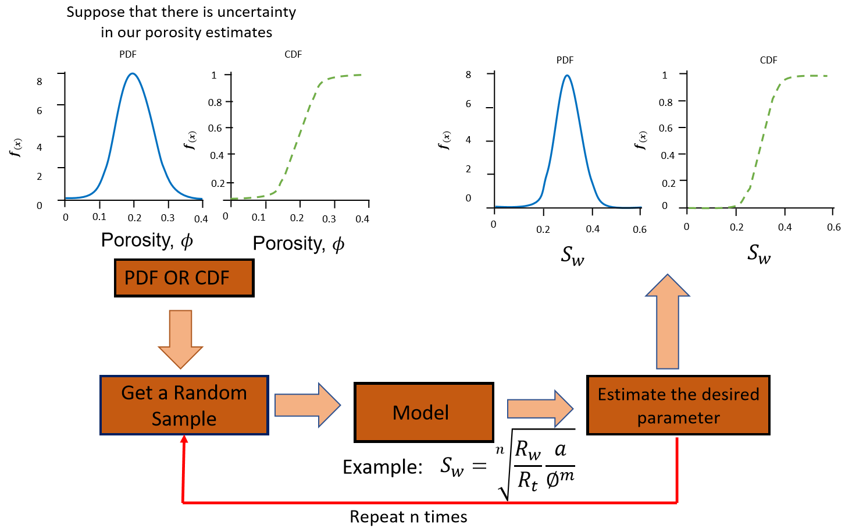
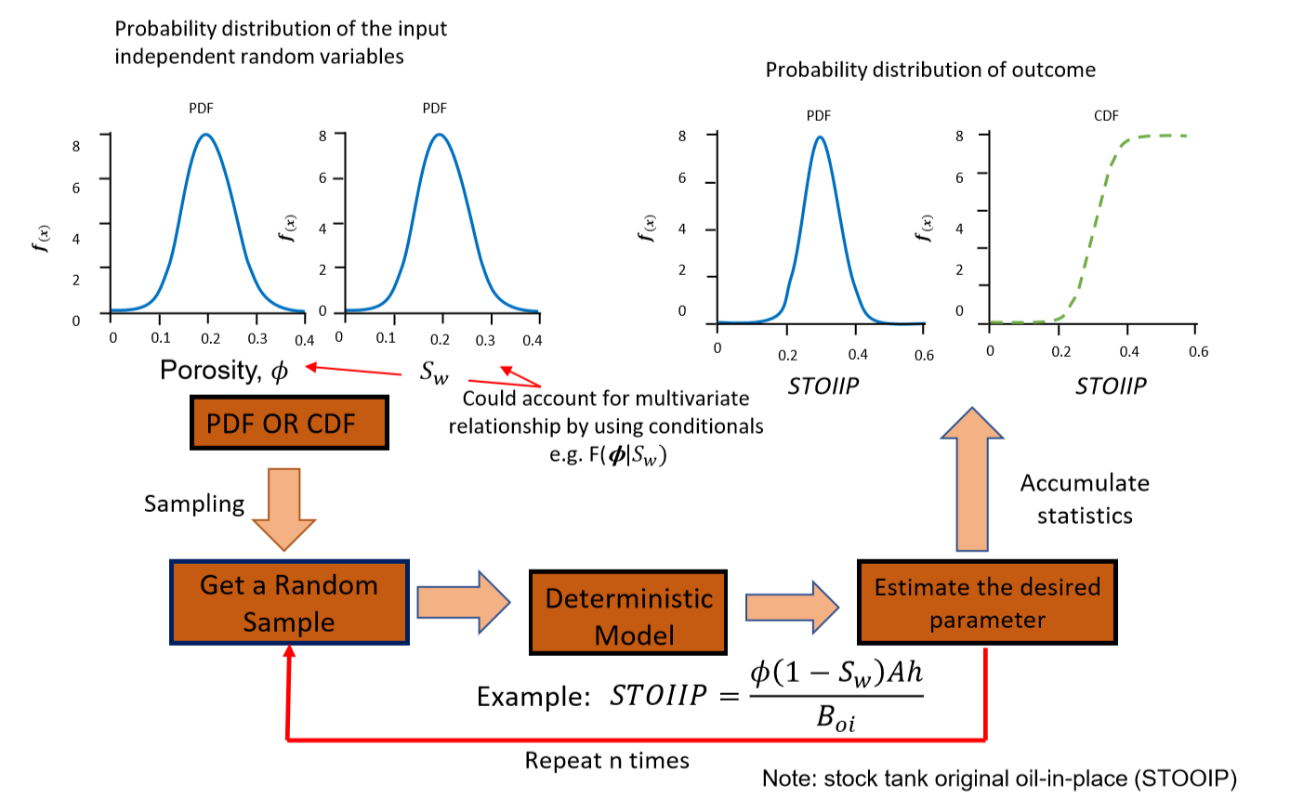
Monte Carlo Simulation
Remember this?
95 % confidence interval
Prob
Sample Mean
From Pyrcz Intro to Geostat slides

Slide 11
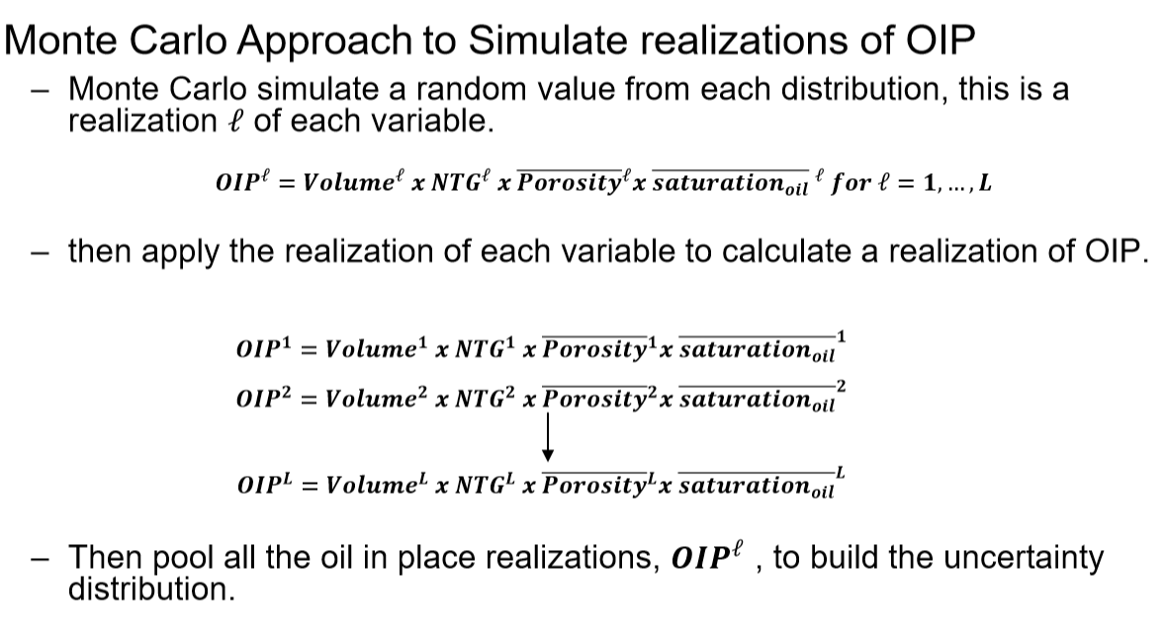
Monte Carlo Simulation
95 % confidence interval
Prob
OIP
Decision Making
From Pyrcz Intro to Geostat slides
Notes:
o. Confidence interval is important for decision making. It is what you give to your boss!

Slide 12
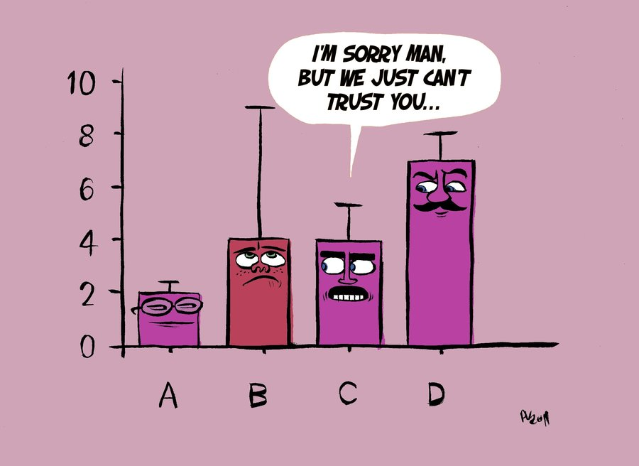
Questions
95 % confidence interval
Prob
Sample Mean

